Slide 1

Woman
Health
Stroke Analysis
&
Prevention
Team Name : CG Millennial Garage Group
Team Member : Dipti Pachouri
Anuja Shrike
Snehal Gaikwad
Sanjana Kongara

Slide 2

Sustainability
Gender equality today for a sustainable tomorrow
Women impact natural resource management through their various roles in households, the economy, and society. Therefore, gender equality is crucial to ensuring a balanced approach to the economic, social and environmental dimensions of sustainable development and achieving all SDGs.
Good Health and Good Wealth
A healthy lifestyle can assist you in thriving for the rest of your life.

Slide 3
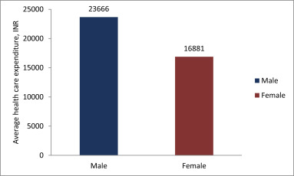
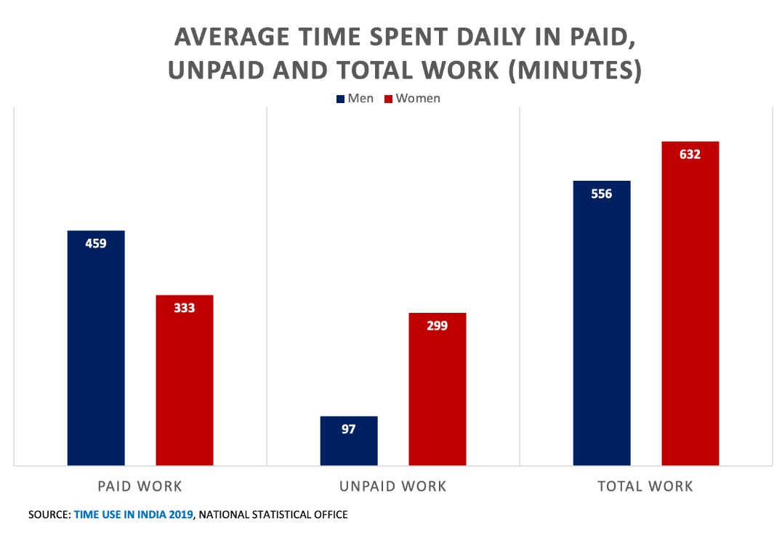
Gender Inequality
Average health care expenditure for male is Greater than that female Whereas female needs health care services equally or more than male.
Women are doing more unpaid work than men.
Women that handle both household and office experience more stress
and as there is inequality in health care expenditure Women can't take advantage
of health care facility.
This is the reason we need gender equality and sustainability.

Slide 4
AGENDA
01
Model Flow Chart
What is Stroke
02
Stroke definition.
Stroke symptom.
Steps of work process
There mention Algorithm
Azure Technology for
Analysis
Azure Web Application for Solution
03
04
About Azure Technology.
Analysis the data.
Take solution after analysis
About Web Application

Slide 5
About dataset
We downloaded the dataset form Kaggle.
The data contains 2994 records.
There are 12 features in the dataset like hypertension, BMI, Smoking habits, Residence type , work profession etc.
Here we are comparing having stroke and not having stroke in a women.

Slide 6

What is Stroke?
A stroke, sometimes called a brain attack, happens when blood flow to an area of the brain is blocked or when a blood vessel in the brain bursts.
Symptoms of stroke:
Problems seeing in one or both eyes.
Headache.
Trouble speaking and understanding what others are saying.
Paralysis or numbness of the face, arm or leg.
Trouble walking.

Slide 7
Azure Machine Learning Services

Slide 8
Model Flow Chart
DATASET
DATA PROCESSING
MACHINE LEARNING ALGORITHM
MISSING DATA ANALYSIS
CATBOOST
HANDLING
IMBALANCED DATA
MODEL BUILDING
& COMPARING
LABEL ENCODING
SMOTE
AZURE WEB APPLICATION (FLASK)

Slide 9

Azure Machine Learning
#1
#2
Make Resources
Data Processing
Make resources for using
Azure machine learning
Services.
Clean, Balance and Label the dataset.
#3
#4
Model Building
Web Application
Algorithm for model building.
Flask Web Application deployed on Azure predicts chances of stroke.

Slide 10



Data Analysis
16.8%
99%
Working women have more chance having stroke than non- working women.
113 women suffer from heart disease out of these 19 woman have stroke.
14.1%
276 women suffer from hypertension out of these 39 women have stroke.

Slide 11
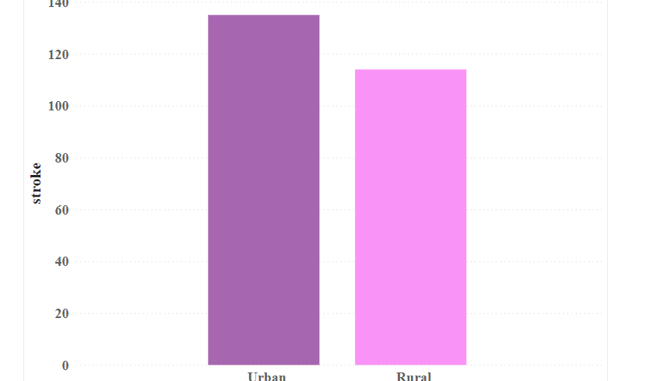
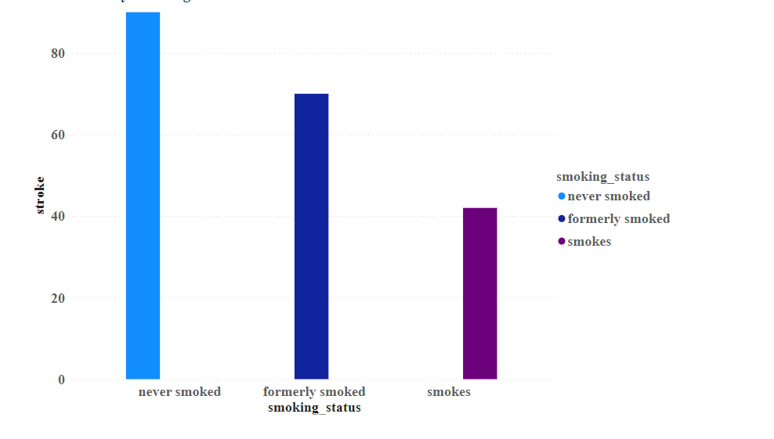
Data Analysis
Stroke rate by residence type
Stroke rate by smoking habit
Urban women have more chance of stroke as compared to Rural women.
Women have some chances if they smoke regularly and formerly.

Slide 12
FUTURE SCOPE
(For Stroke Prevention)

Slide 13

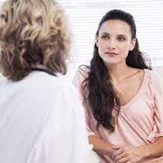

Ideas for Stroke prevention
YOGA
COUNSELING
Yoga can help manage stress, keep blood pressure and cholesterol under control, thereby lowering the risk of having a stroke.
Motivational Therapy Helps Treat Stroke Patients. Study Shows Talk Therapy Reduces Risk of Depression and Improves Odds of Survival.
Awareness campaign
Stroke support organizations are non-governmental organizations that globally drive better outcomes in stroke prevention.

Slide 14



स्त्री SVASTH
Web Application for Stroke
Prevention

Slide 15




FEATURES OF
स्त्रीSVASTH
YOGA Tutorial
NGO Website
Free video is available in the site for yoga tutorial.
This website provide NGO Website.
Free Campaign
.
Provides free campaign
Information in the web page.

Slide 16
Conclusion
Our project provides solution on Women’s Health. We used a data available on Kaggle about Stroke Prediction.
We built a Predictive model on the data that will help in prediction if a women is susceptible for stroke or not.
In web application (स्त्री SVASTH) , the user will input some basic parameters like age, BMI(Body Mass Index), glucose level and smoking status and accordingly the model will predict for stroke.
Our web application also have some Preventive measures on stroke.
The page contains some postures of Yoga, online counselling sessions and information about NGOs working on women's health.

Slide 17


Reference
DATASET LINK

Slide 18
Thank You

